Slide 1

Airplane In-flight entertainment system
Cybersecurity internship
Week 8
Intern: Assil Bzal

Slide 2
Outline
Define assets
Top threats
Quick mitigations
Likely attackers
Entry points
Trust boundaries
Diagrams : DFD – Sequence diagrams

Slide 3
Assets | Description | Security Sensitivity
Passenger | Human user of the IFE system | Can be both legitimate user or attacker
Seat-Back IFE GUI | Passenger-facing entertainment interface | Accepts input and processes media requests
IFE Server | Central processing node for media and payments | Handles requests and connects to multiple systems (DBs, avionics)
Media Database | Stores movies, music, other entertainment content | Classified SECRET – may hold DRM or licensed data
Payment/ PII Database | Stores passenger payment data | SECRET – contains sensitive personal and financial info
Avionics interface | Bridge between IFE and aircraft avionics | Safety-critical; potential lateral movement risk
Inflight network infrastructure | Routes traffic between onboard systems | Shared medium — potential choke point
USB/HDMI/Bluetooth/Ports | Physical access points for passengers | Attack vector for malware or rogue devices
Cabin Wi-Fi/Passenger interfaces | Wireless access network for passengers | Entry vector for network attacks
Maintenance/ Service Port | Access for diagnostics and updates | Requires protection from misuse
Content delivery/ ground sync | Updates media and system content | Part of supply chain; potential vector for malicious updates

Slide 4
Threat | Severity | Related component | Description | Mitigation
Lateral movement to critical avionics | 🔴 High | IFE Server | Misconfigured network bridge could allow attackers from passenger IFE to reach avionics systems | Enforce strict network segmentation; physical separation; unidirectional gateway
Theft of payment/PII | 🔴 High | Payment/PII DB | Compromised IFE or server could expose financial or personal data | Encrypt at rest and in transit; implement PCI-DSS compliance; segregate payment systems
Malware via USB/OTG or infected content | 🟠 Medium | USB/Bluetooth Ports | Passengers could plug infected media or exploit OTG interfaces | Disable unused ports, use endpoint protection, restrict file execution
Denial of service | 🟠 Medium | Inflight Network | Network flood or process overload could disrupt entertainment or communications | Rate-limiting, IDS/IPS, redundancy, monitoring
Unauthorized content injection | 🟡 Low | Content Sync | Tampered updates could inject malicious or pirated content | Code signing, integrity validation of content packages, supply-chain vetting

Slide 5
Quick mitigations
Domain | Recommended controls
Network segmentation | Physically isolate IFE from avionics; enforce strict VLAN/firewall policies
Access control & authentication | Require signed firmware, authenticated maintenance access, least privilege
Data protection | Encrypt PII & payment data at rest (AES-256) and in transit (TLS 1.3)
Input validation & hardening | Sanitize input on IFE server; disable unneeded ports; harden OSes
Monitoring & logging | Implement SIEM or onboard monitoring for anomalies
Incident response | Create onboard alerting for network anomalies or content tampering
Supply chain security | Validate ground content updates; signed packages and hashes
Physical security | Tamper-evident seals, port disablement, and hardware lockdowns

Slide 6
Likely attackers
Attacker | Motivation | Capability
Malicious passenger | Entertainment system bypass, free media, curiosity | Physical & logical access (seat-back, USB, Wi-Fi)
Cybercriminal / data thief | Steal payment or PII | Exploits IFE vulnerabilities
Insider or compromised maintenance operator | Tamper with content or data | Physical or privileged access
Nation-state / APT | Interfere with avionics or disrupt flight operations | Advanced capabilities targeting avionics bridge
Malware via USB/ portable media | Spread infection | Exploits lack of port security

Slide 7
Entry points
Entry point | description | Potential risks
Seat-back GUI | Passenger input interface | Command injection, buffer overflow
USB/HDMI/Bluetooth Ports | Direct physical access | Malware injection, data exfiltration
Cabin Wi-Fi | Wireless access | Network sniffing, rogue client attacks
Content Sync (Ground) | Updates from airline or vendor | Supply chain tampering
Maintenance Port | Onboard diagnostics | Unauthorized access
IFE Server → Avionics Interface | Misconfigured bridge | Cross-domain attack, lateral movement

Slide 8
Trust Boundaries
Boundary | Description | Contained Assets
Passenger Area | Untrusted / public | Passenger, IFE GUI, USB/Bluetooth, Cabin Wi-Fi
Airline-Controlled IFE Systems | Semi-trusted operational network | IFE Server, Media DB, Payment DB, Network Infra, Content Sync
Aircraft Avionics Systems | Highly trusted / safety-critical | Avionics Interface

Slide 9
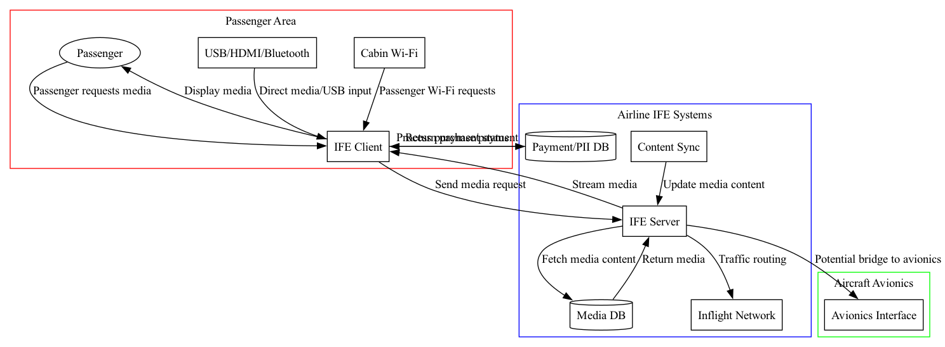
Data flow diagram + trust boundaries

Slide 10
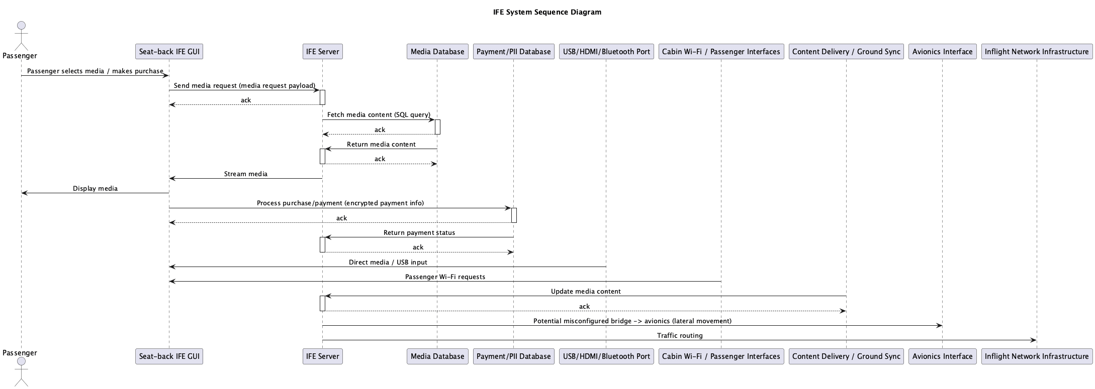
Sequence diagram

Slide 11
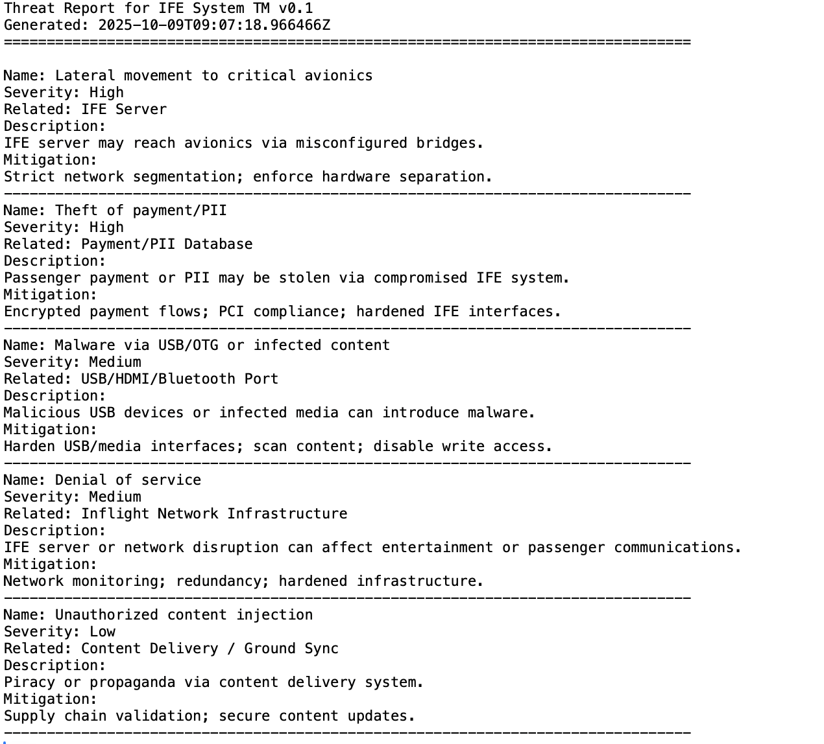
Threat report

